Slide 1
Regulatory Support System (RSS) Modernization Training
Portal, Roster Maintenance, Regulatory, and Reports
March 2022

Slide 2
Agenda
Overview
Purpose of the RSS Modernization (5 minutes - James)
Access (see above - James)
Common Features (James 5 minutes)
The Portal (5 minutes - Martha)
Roster Maintenance (15 minutes - Martha)
Regulatory (15 minutes - Ryan)
Reports (10 minutes - James)
Next Steps (5 minutes - James)
Please hold questions until the end of each section

Slide 3
Overview

Slide 4
Purpose of the RSS Modernization
Modernize the look, feel, and functionality of RSS from the Oracle forms User Interface (UI) to a modern web-based, Single Page Application (SPA) using ReactJS
Ensure current functionality remains in place while setting the stage for future enhancements
Support smaller, more modular applications allowing for updates/maintenance to a single application without disruption to all applications
Framework and components are extensible across applications improving consistency across applications
Standardize access rules and centralize monitoring of systems for common issues

Slide 5
Access
Requirements for Access to Modernized Applications for Cancer Trial Support Unit (CTSU), National Cancer Institute (NCI), authorized NCI contractors and support services, and Lead Protocol Organization (LPO) staff
Active CTEP Registration Status
Uses CTEP Identify and Access Management (IAM) credentials
Active roster status on the CTSU roster aligned with the administrative organization (e.g., Alliance, IROC-Houston, DCTC, etc.)
Appropriate staff role for read (general) access (e.g., NCI Staff, LPO Staff, etc.)
Appropriate role for write access (e.g., LPO Protocol Specialist, LPO Roster Owner, etc.)

Slide 6
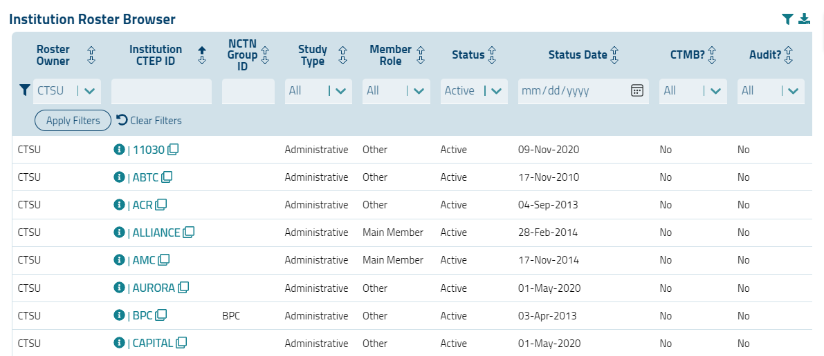
Common Experience – Browsers and Export

Slide 7
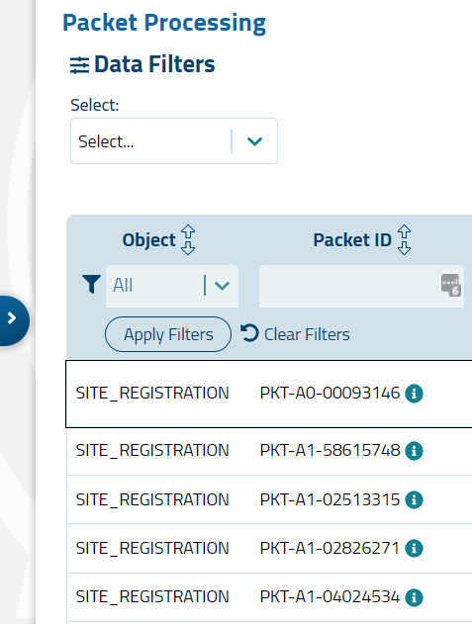
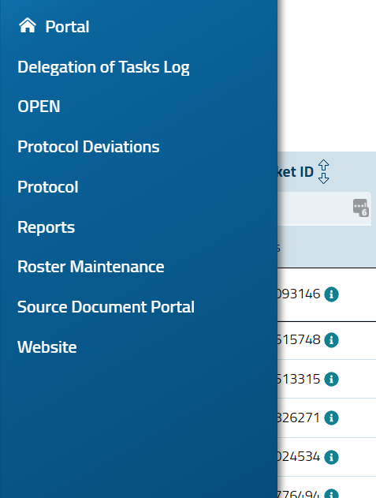
Common Experience – Navigation Between Applications
Navigation between applications will use the “spine”
Spine Collapsed | Spine Expanded

Slide 8
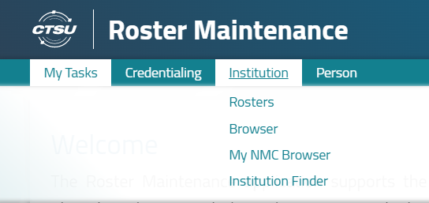
Common Experience – Navigation Within Applications
There are two primary navigation methods within a single application:
Menu items
Links

Slide 9
Common Experience – Error Messages
Error/notification messages appear in one of three ways:
In a pop-up window
Near a relevant data field
As a “toaster” message

Slide 10
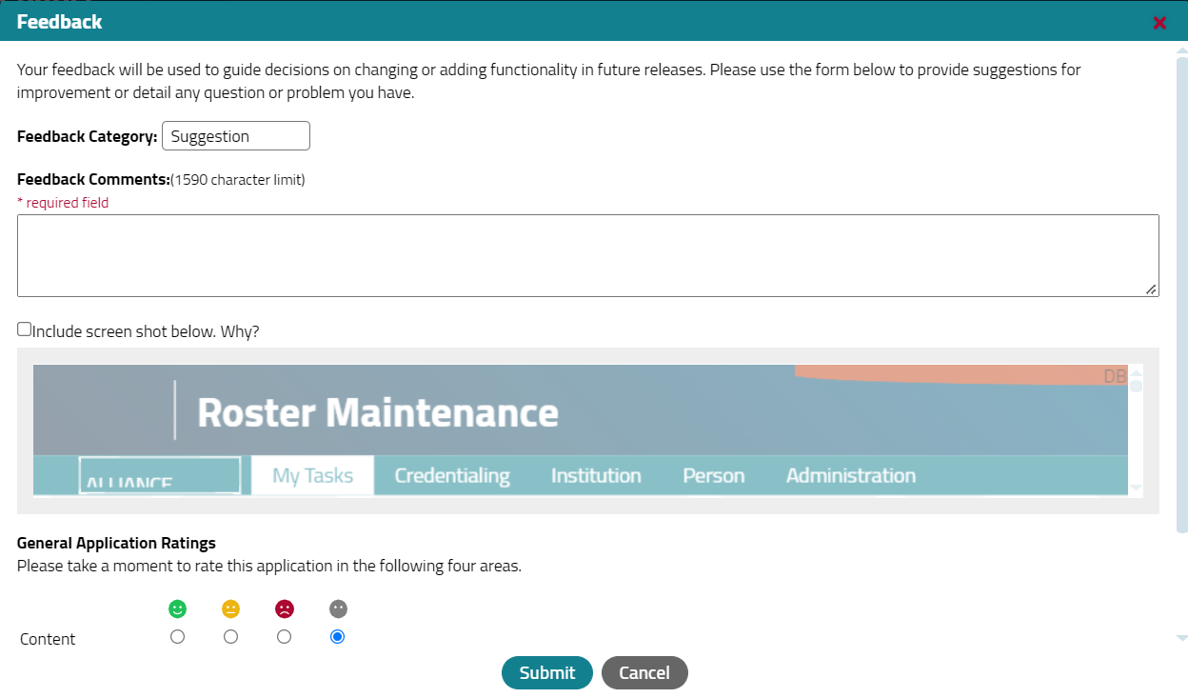
Common Experience – Help and Feedback
Tool | Appearance | Notes
Help |  | Available on every application page Specific links may be context-specific
Feedback |  | Available in each application menu Use to provide overall application feedback or report an issue

Slide 11
The Portal

Slide 12
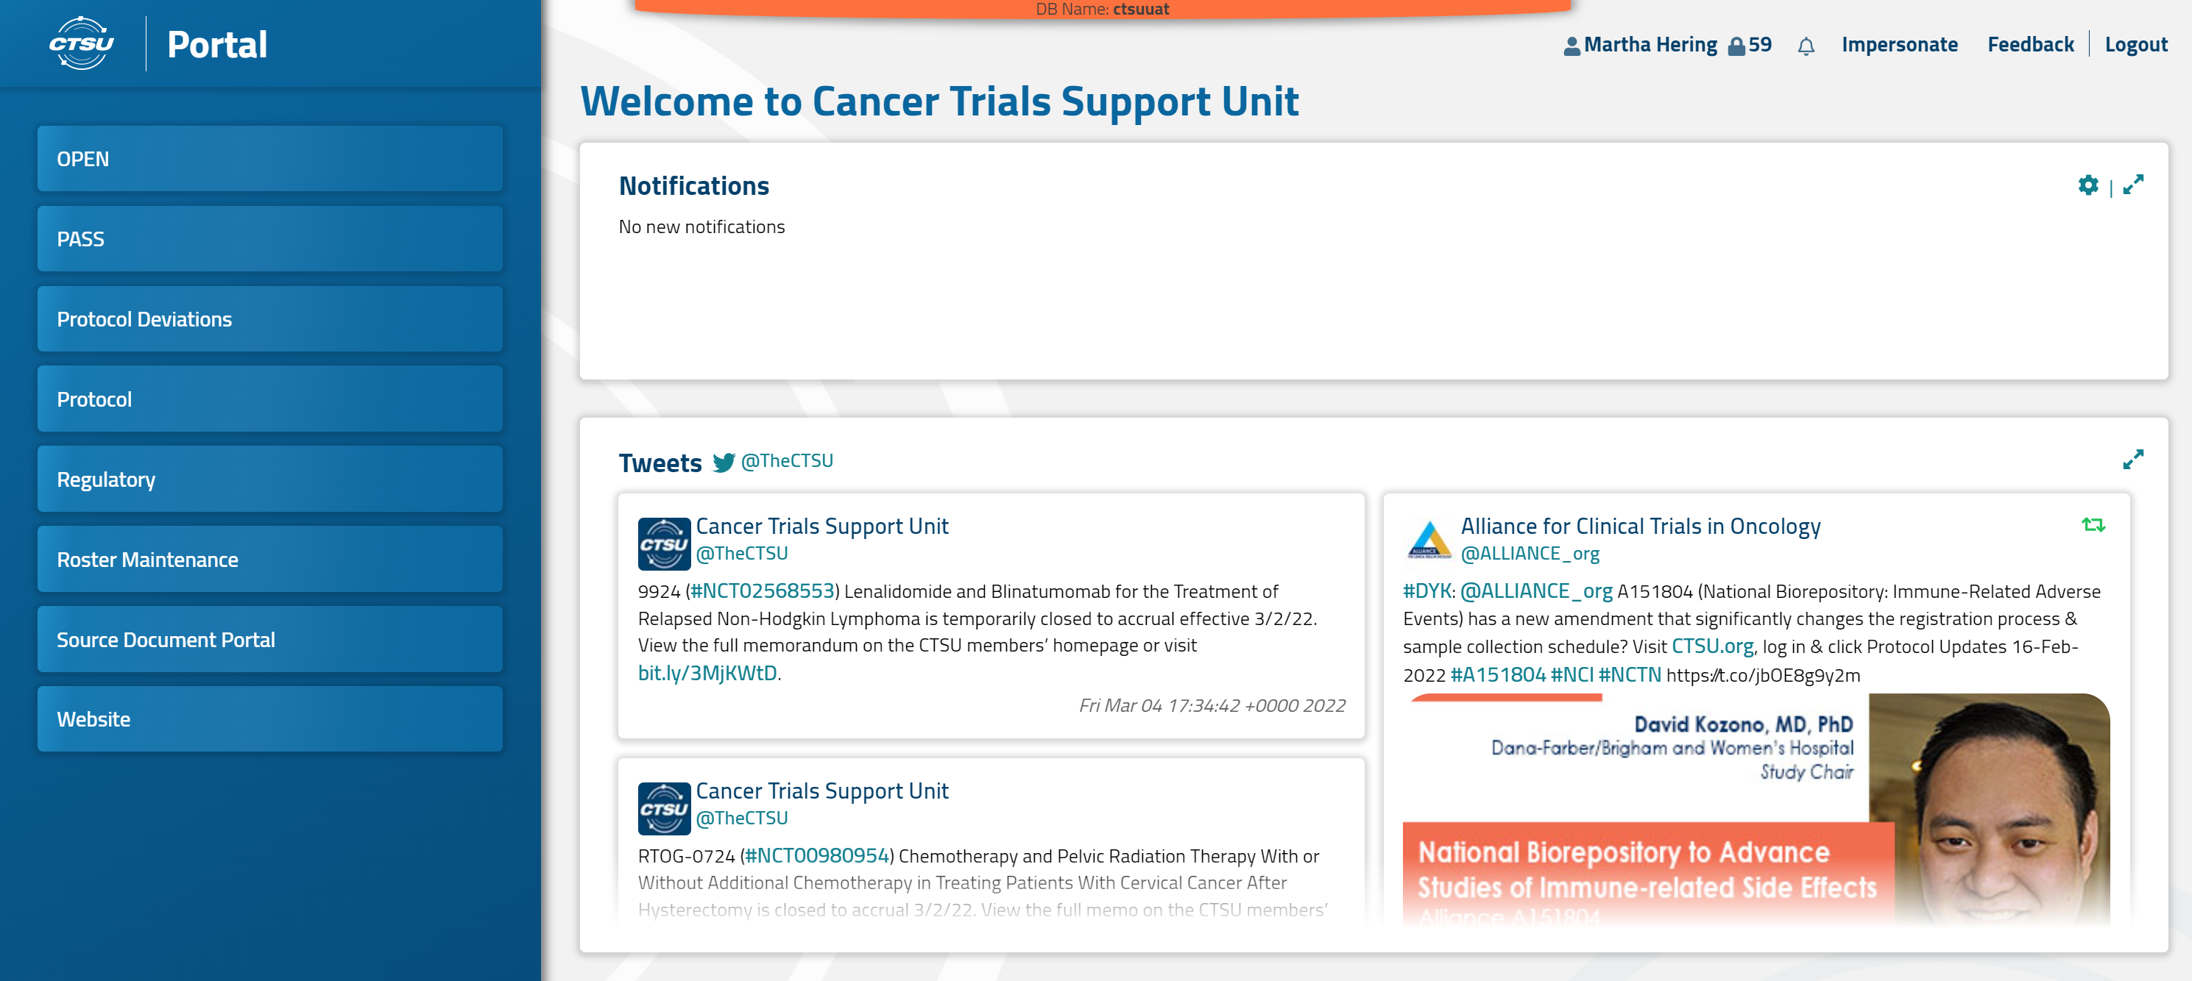
The Portal
Acts as a gateway to modernized application to which you have access

Slide 13
Roster Maintenance

Slide 14
Roster Maintenance
Features
My Tasks (Welcome)
Credentialing
Institution
Browsers
Finders
Person
Browsers
Finders
Administration (Coming Soon)

Slide 15
Roster Maintenance - What is Continuing
Roster business rules for assignment of unique CTEP identifiers for institutions and persons continue to be enforced
Roster business rules for the Experimental Therapuetics Clinical Trials Network (ETCTN) and National Clinical Trials Network (NCTN) continue to be enforced
Business rules for adding persons or automated removal of persons based upon CTEP status continue to be enforced
Business rules for setting institution and person statuses were refined and continue to be enforced
Real-time Data Transfer System (RDTS), CTSU Enterprise Web Services (CEWS), and CENTER are unaffected
Integrations with NCORP-SYS and the CTEP-ESYS continue

Slide 16
Roster Maintenance – What has Changed
For a Future Release
Copy persons from one institution record to another
Mass update of person roster statuses from the Person Roster Browser
CTSU Administrative features for Role set up, Roster Update Maintenance set up, and Attributes set up
What won’t be available
Unregistered persons
Unregistered institutions will be moved to a CTSU Administrative function

Slide 17
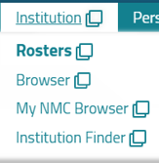
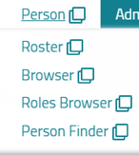
My Tasks
Navigation
Your Info
To Do List
Help Topics
Portal

Slide 18
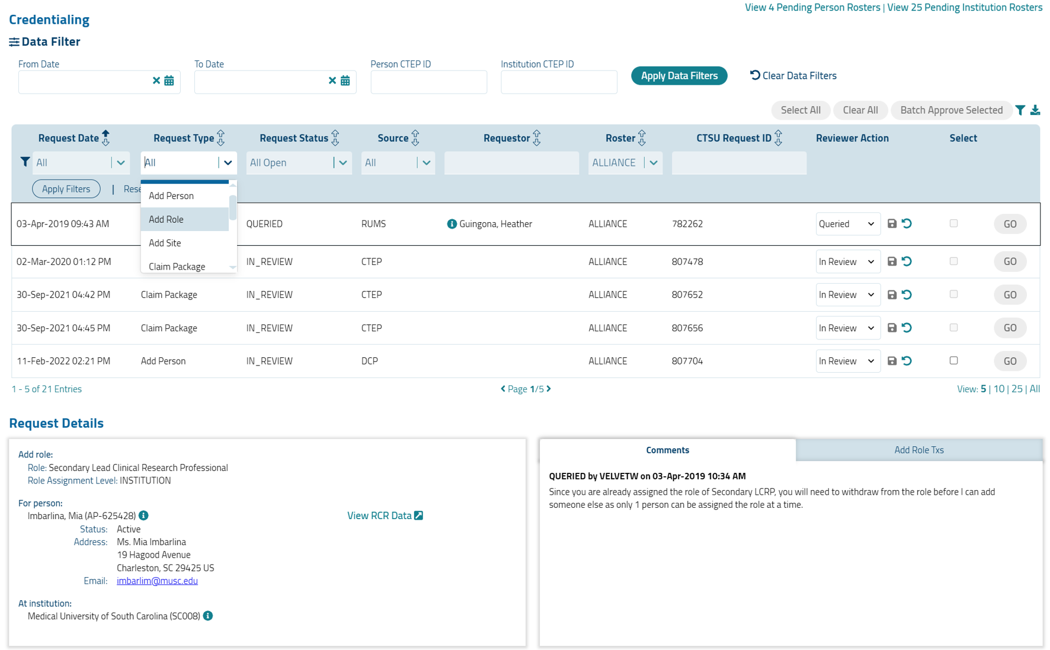
Credentialing
Filters are pre-set to the Roster Owner and may be further filtered by multiple parameters
Actions
View additional details

Slide 19
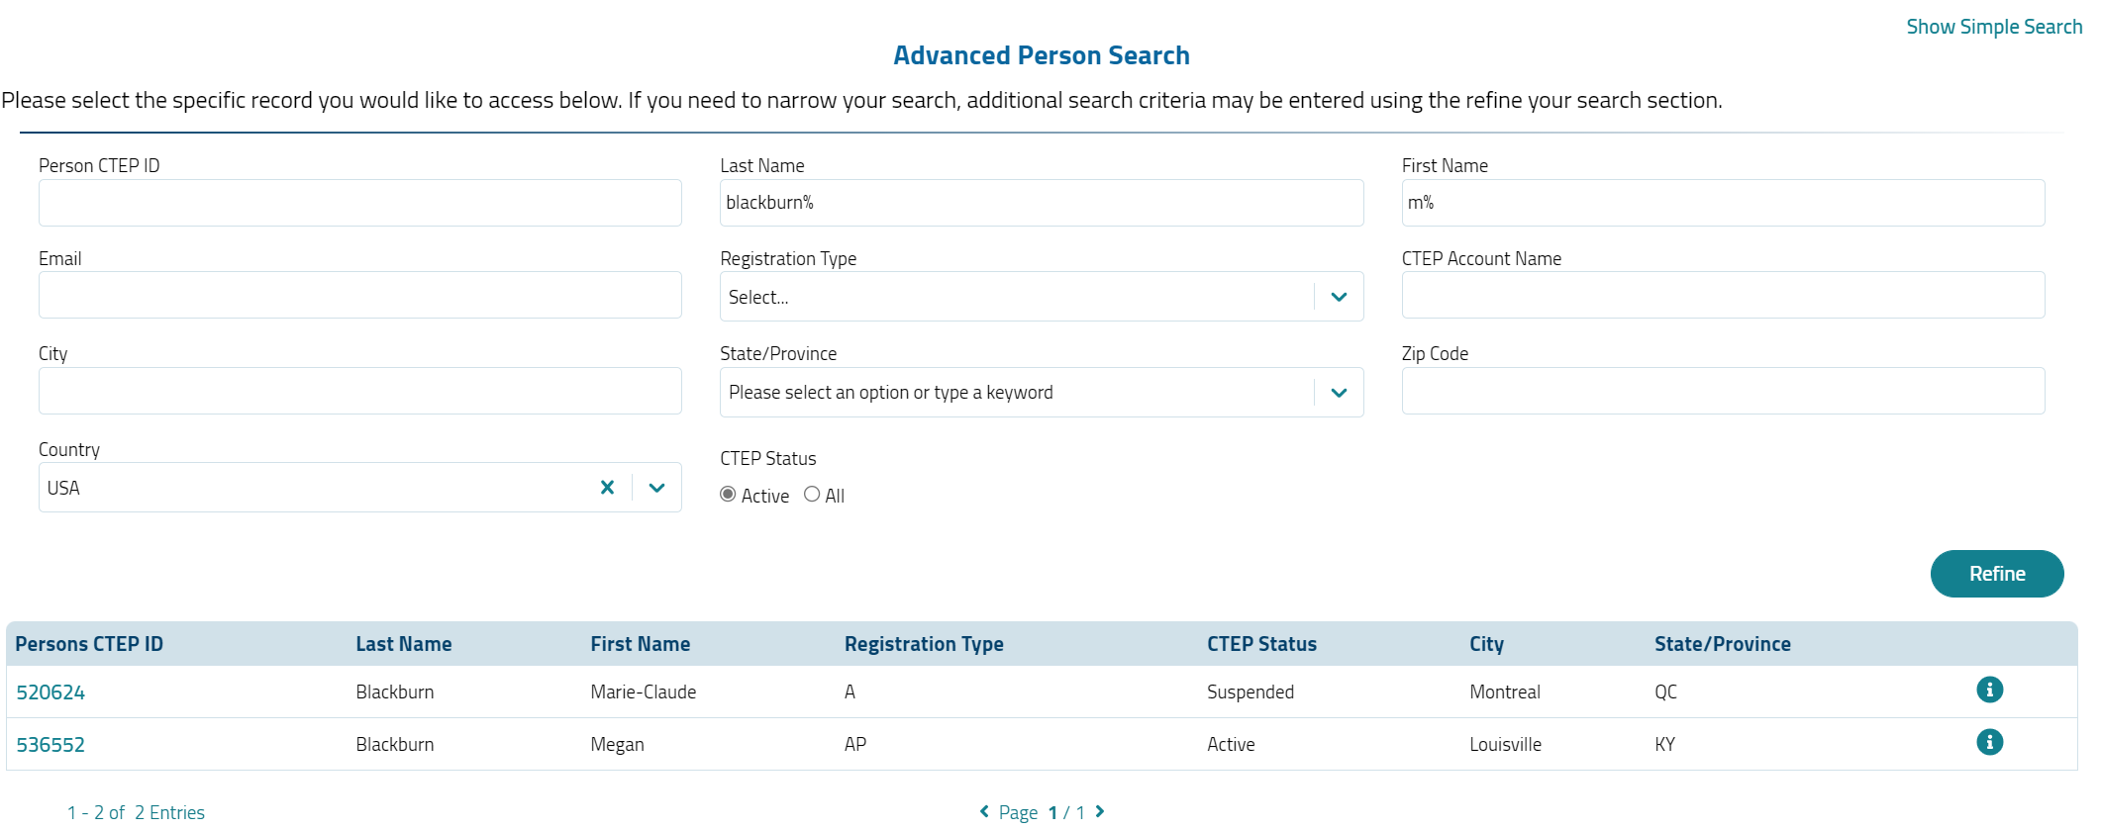
Person Finder – Where’s Megan?
Simple Search – CTEP ID or full/partial name
Note: Type Ahead
Advanced Search Displays if multiple records meet the criteria
Use the i button for detail

Slide 20
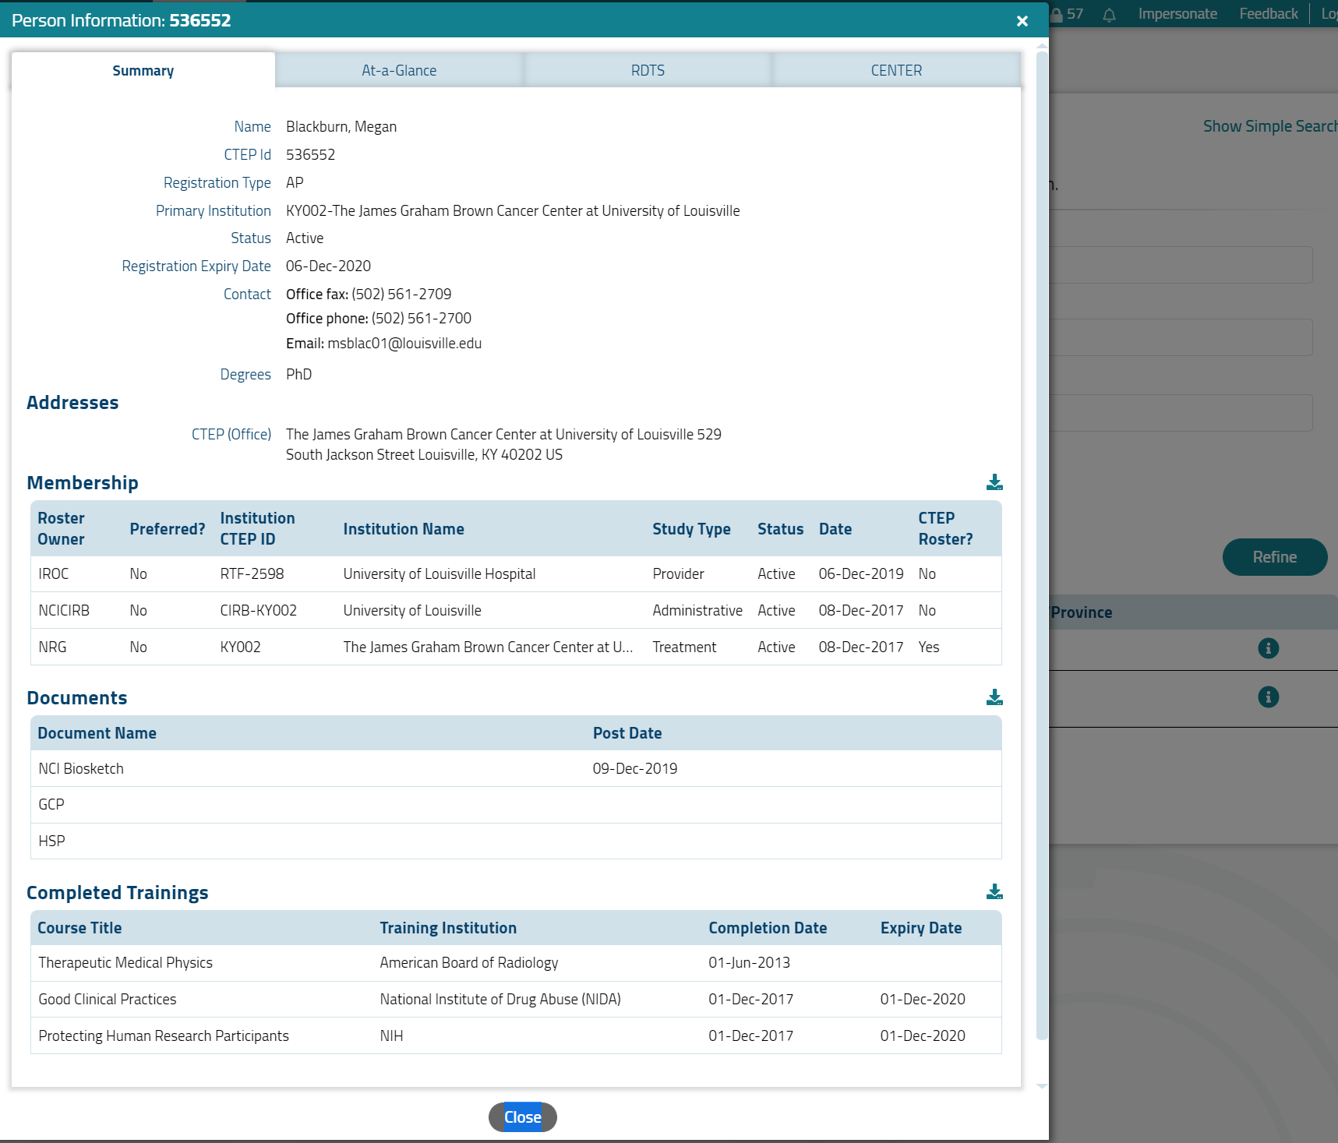
i Buttons – Confirm Search
This is the wrong Megan

Slide 21
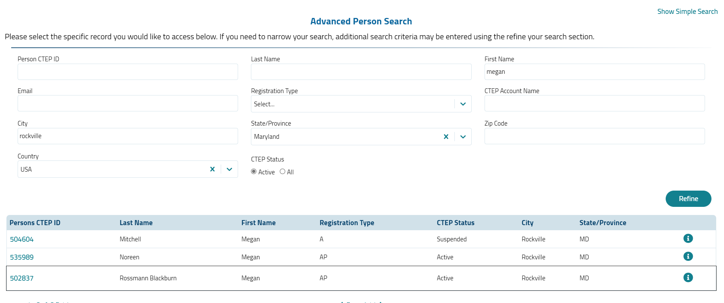
Person Finder - Advanced Search
Try Different Parameters
Verify with i Button

Slide 22
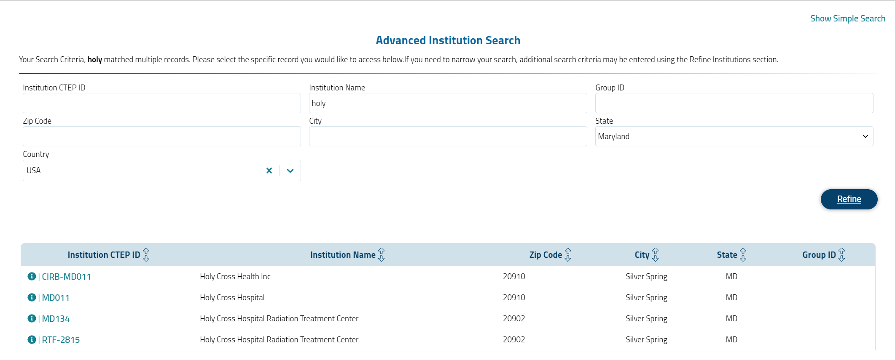
Institution Finder

Slide 23
Institution and Person Attributes
Displays Roster Owner Attributes First
Required Attributes and Fields are Denoted by *
Select Link to edit

Slide 24
Institution and Person Address and Contacts
Edit
Add Row

Slide 25
Institution Browsers
Filter and sort on multiple parameters going from left to right
Downloadable to CSV
Navigate to institution record by selecting the Institution CTEP ID link
May view the associated persons by selecting the Person icon
There is also a separate Non-Member Collaborator (NMC) browser

Slide 26
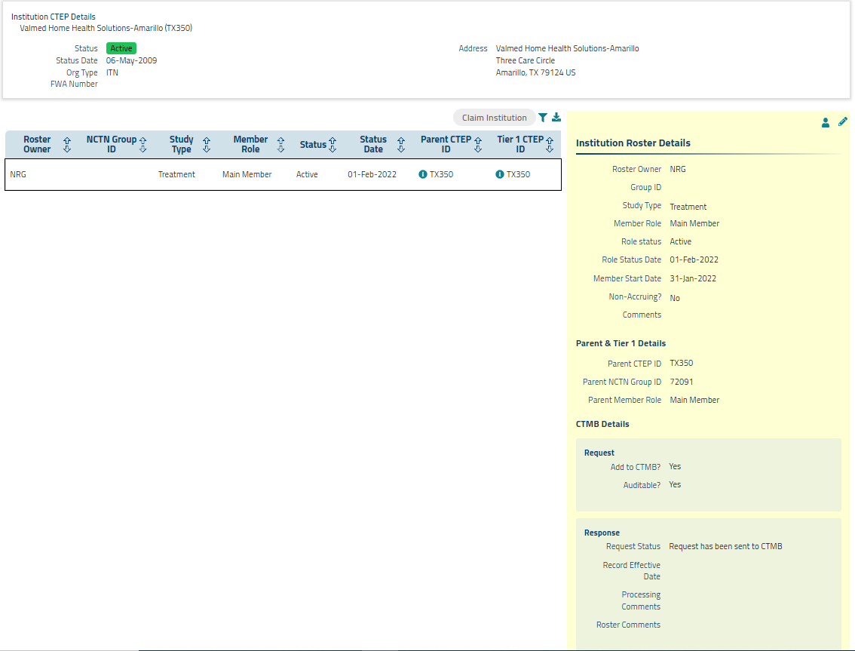
Institution Roster
Allows claim or activation of institution records
Edit institution records
Required attributes must be set prior to claiming the institution
Supports the Audit Information System (AIS) integration
Support post dating but not pre-dating of statuses
NCTN, NCORP, ETCTN, and AMC sites must be active on the CIRB roster
Will be green if site can be claimed form the screen

Slide 27
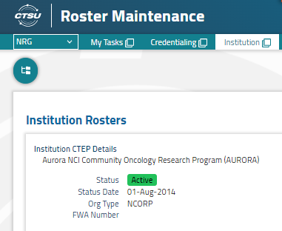
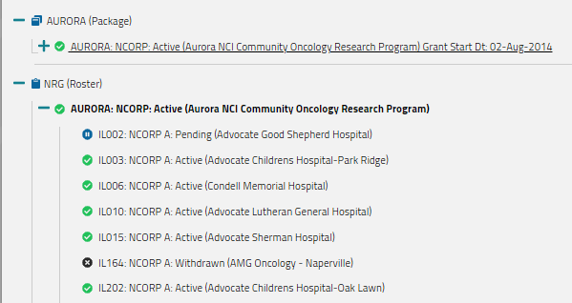
Institution Roster Tree
Future Enhancements:
Pen the tree
View all rosters

Slide 28
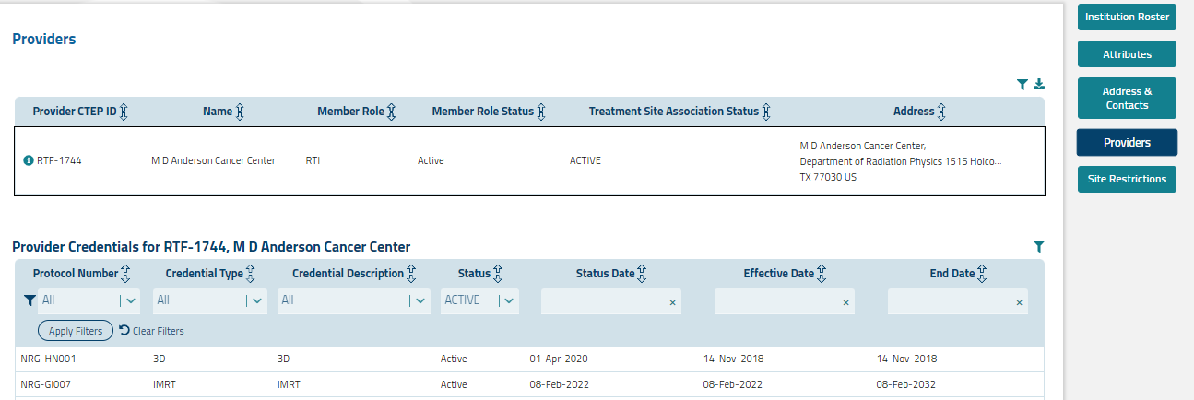
Institution Providers
Display aligned Radiation/Imaging (RT/Is) and Targeted Radio-Pharm Facilities (TRFs)
Display modality credentialing

Slide 29
Person Browser and Role Browser

Slide 30
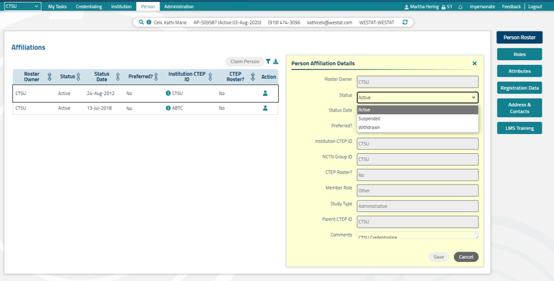
Person Roster
Edit mode; business rules for person status and swim lanes are enforced

Slide 31
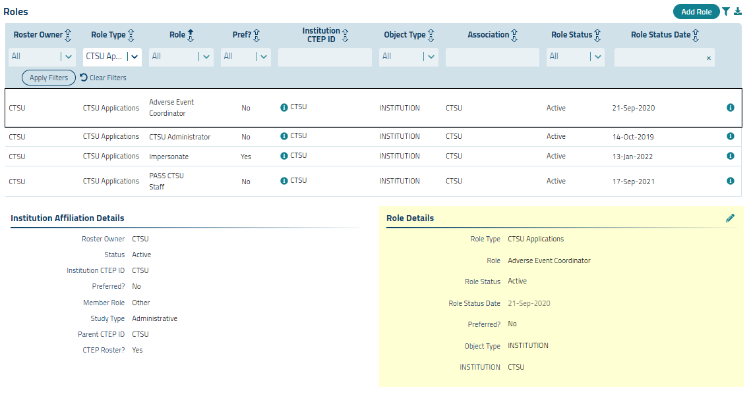
Person Roles
Add roles
Filter for roles
Edit roles

Slide 32
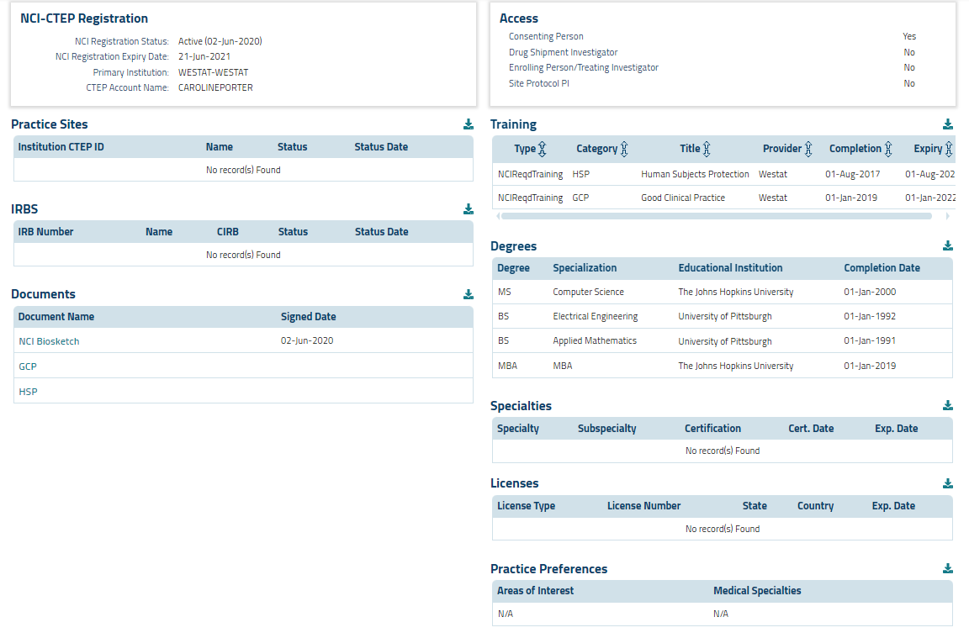
Person Registration Data

Slide 33
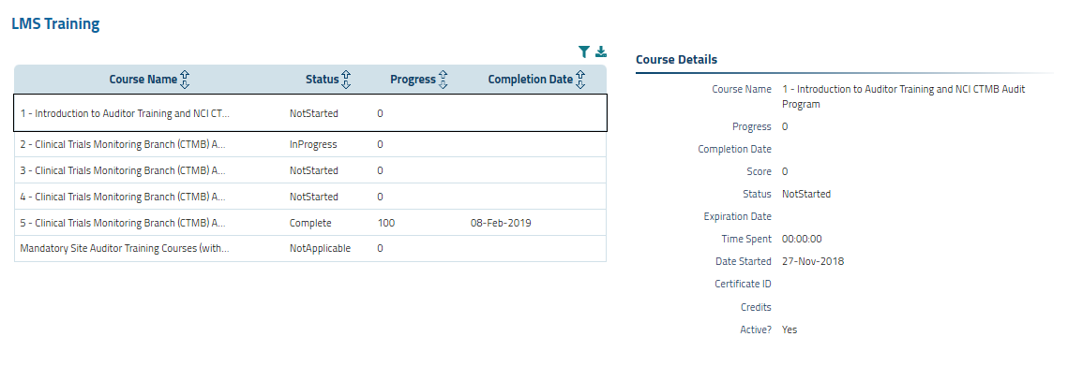
LMS Training

Slide 34
Regulatory

Slide 35
Regulatory – What has Changed
No More Packet Screen
Packet Browser and the Packet Screen have been merged into one screen, the Packet Processing Screen, which incorporates all of the previous functionality of both screens
Data Filters (Person ID, Site ID, Protocol) have been pulled out of the grid search
Links to IRB Approval screen (IRB) and Site Registration screen (SR) are in the Indexing section
Additional Details now includes the following information
Submission Content
Submitter Contact Info
Processing Info; such as Priority, Assigned to, Status, Class, and Internal and External Comments

Slide 36
Packet Processing Demo

Slide 37
Packet Processing

Slide 38
Packet Processing - 2

Slide 39
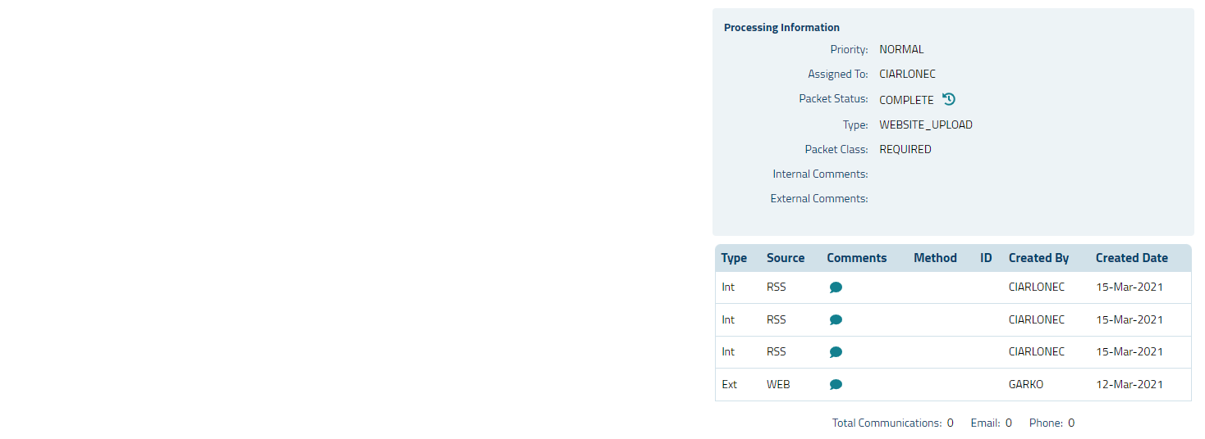
Packet Processing - 3

Slide 40
Site Registration Browser Demo

Slide 41
Site Registration Browser

Slide 42
IRB Approval Browser Demo

Slide 43
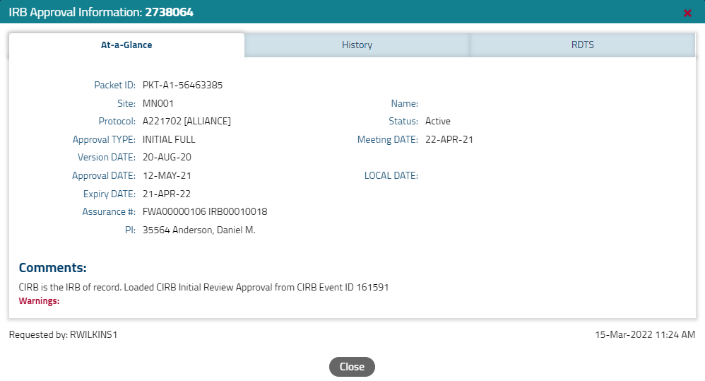
IRB Approval Browser

Slide 44
Reports

Slide 45
Report - What is Continuing
Centralized access to on-demand reports for multiple domains (e.g., Regulatory, Funding, Accrual)
Customizable report parameters to return specific relevant results
Available report formats include PDF, CSV, and XLSX (not all formats are available for every report)
Stakeholders can request custom reports when a suitable report is not available in the application

Slide 46
Reports – What has Changed
Filterable and sortable table of available reports
Uncluttered interface
Ability to view full report description at one time
Availability of “shell” report before execution

Slide 47
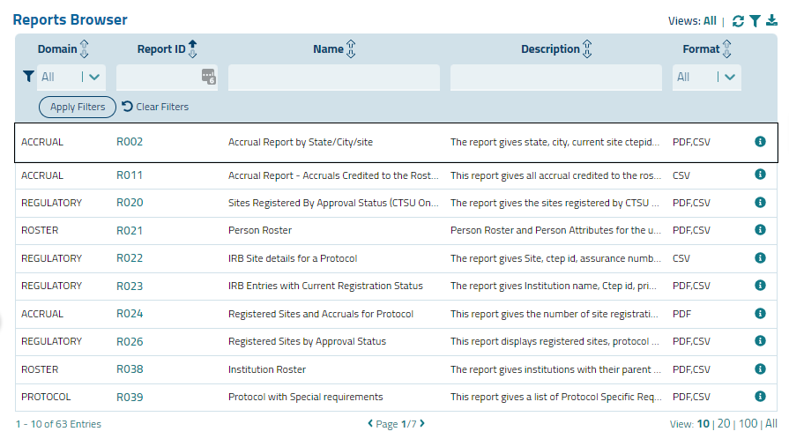
The Reports Browser

Slide 48
The Reports Browser, with Description

Slide 49
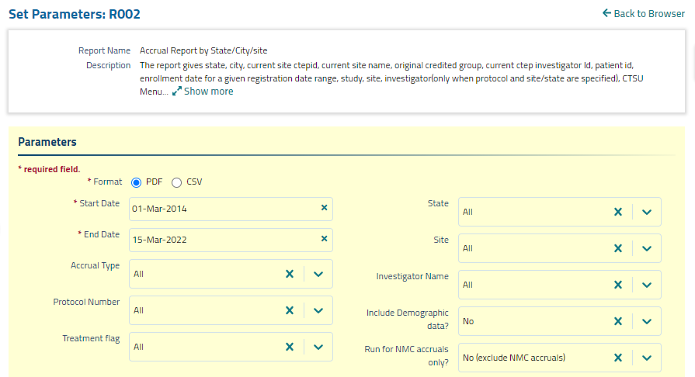
The Set Parameters Screen

Slide 50
Next Steps

Slide 51
Next Steps
Currently the Portal, Rostering and Regulatory are in internal production
If you have access to the Protocol application, you will be able to view these applications
Write access has not yet been assigned
Feel free to look around
Will be reaching out to the RSS Authorizer/Membership Staff to determine who needs write access to Rostering; confirm RSS access
Plan to go to full production with release of the Reports application in this spring
.jnlp RSS will continue to be available for a limited time, but will be retired in mid-summer

Slide 52
More Help
Help Topics will be available for all applications
Contact Martha Hering (marthahering@Westat.com) and Caroline Porter (carolineporter@Westat.com) with questions
We can provide targeted Lead Protocol Organization/Roster Owner organization trainings upon request after the full production release

Slide 53
Thank You
Thank You

